Slide 1
Module 3 IoT Protocol Suite

Slide 2
IoT Protocol Suite - Topics
Physical layer,
Link layer -BLE, LoRaWAN
Network layer,
Transport layer,
Application Layer protocols - MQTT, CoAP
Communication Models.

Slide 3
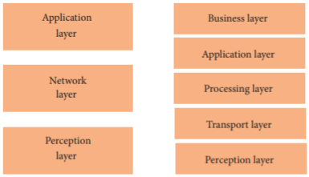
Layer’s - Architecture of IoT
3 Layer
5 Layer

Slide 4
3 Layer- Architecture of IoT
The perception layer is the physical layer, which has sensors for sensing and gathering information about the environment. It senses some physical parameters or identifies other smart objects in the environment.
The network layer is responsible for connecting to other smart things, network devices, and servers. Its features are also used for transmitting and processing sensor data. (BLE, Wi-Fi, LoRAWAN)
The application layer is responsible for delivering application specific services to the user. It defines various applications in which the Internet of Things can be deployed, for example, smart homes, smart cities, and smart health.

Slide 5
5 Layer- Architecture of IoT
The perception layer is the physical layer, which has sensors for sensing and gathering information about the environment. It senses some physical parameters or identifies other smart objects in the environment.
The transport layer transfers the sensor data from the perception layer to the processing layer and vice versa through networks such as wireless, 3G, LAN, Bluetooth, RFID, and NFC.
The processing layer is also known as the middleware layer. It stores, analyzes, and processes huge amounts of data that comes from the transport layer. It can manage and provide a diverse set of services to the lower layers. It employs many technologies such as databases, cloud computing, and big data processing modules

Slide 6
5 Layer- Architecture of IoT
The application layer is responsible for delivering application specific services to the user. It defines various applications in which the Internet of Things can be deployed, for example, smart homes, smart cities, and smart health.
The business layer manages the whole IoT system, including applications, business and profit models, and users’ privacy.
This Layer also has the responsibility to design, analyze, implement, evaluate, and monitor the requirements of the IoT system.
This layer can use big data analysis to support decision-making activities.
performs a comparison of obtained versus expected outputs to enhance the quality of services.

Slide 7
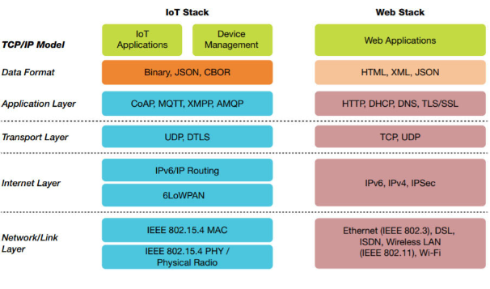
Arrangement of Protocols in IoT
A binary format is a format in which file information is stored in the form of ones and zeros, or in some other binary (two-state) sequence.
Concise Binary Object Representation (CBOR) is a binary data serialization format loosely based on JSON
JSON – Java Script Object Notation
UDP – User datagram Protocol
Datagram Transport Layer Security (DTLS) is a communications protocol providing security to datagram-based applications by allowing them to communicate in a way designed to prevent eavesdropping, tampering, or message forgery.
CoAP – Constrained Application protocol
MQTT – Message Queuing Telemetry Transport ;
Extensible Messaging and Presence Protocol is an open communication protocol designed for instant messaging (IM), presence information, and contact list maintenance. Based on XML (Extensible Markup Language), it enables the near-real-time exchange of structured data between two or more network entities.

Slide 8
IoT Access Technologies
The technologies that IoT access for connectivity.
Topics addressed:
Physical layers (The wired or wireless methods and relevant frequencies)
MAC layers (Considerations at the Media Access Control (MAC) layer, which bridges the physical layer with data link control)
Topology (The topologies supported by the technology)
Security (Security aspects of the technology)

Slide 9
IoT Access Technologies
IEEE 802.15.4: an older but foundational wireless protocol for connecting smart objects.
IEEE 802.15.4g and IEEE 802.15.4e: are targeted to utilities and smart cities deployments.
IEEE 1901.2a: which is a technology for connecting smart objects over power lines.
IEEE 802.11ah: a technology built on the well-known 802.11 Wi-Fi standards that is specifically for smart objects.
BLE: Bluetooth Low Energy
LoRaWAN (Long Range Wide Area Network): a scalable technology designed for longer distances with low power requirements in the unlicensed spectrum.
NB-IoT (Narrow band – IoT) and Other LTE (Long-Term Evolution – 4G) Variations: which are often the choice of mobile service providers looking to connect smart objects over longer distances in the licensed spectrum.

Slide 10
IEEE 802.15.4
IEEE 802.15.4 is a wireless access technology for low-cost and low-data-rate devices that are powered or run on batteries.
Low cost , a reasonable battery life,
Enables easy installation using a compact protocol stack while remaining both simple and flexible.

Slide 11
Applications - IEEE 802.15.4
Commonly found in the following types of deployments:
Home and building automation
Automotive networks
Industrial wireless sensor networks
Interactive toys and remote controls
This standard is a well known solution for low-complexity wireless devices with low data rates that need many months or even years of battery life.

Slide 12
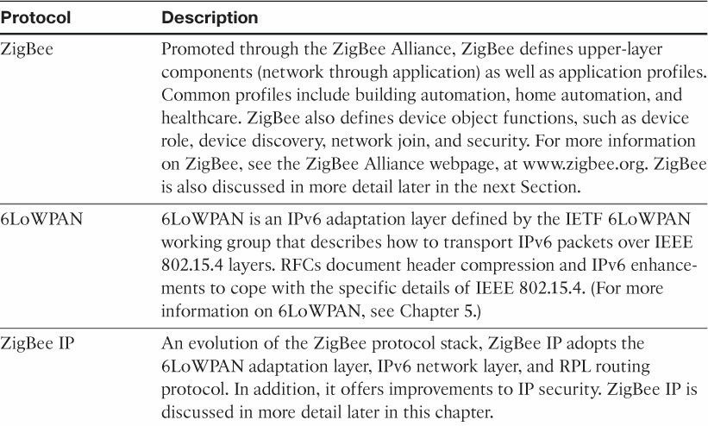
Protocol stacks based on 802.15.4

Slide 13
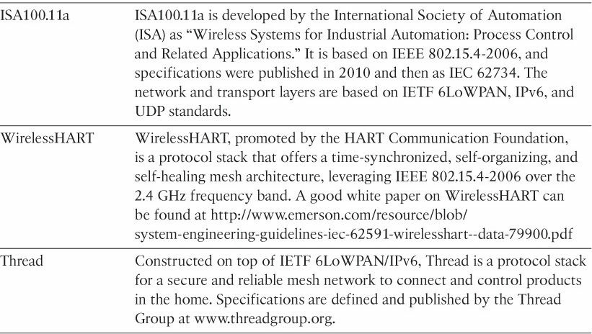
The IEEE 802.15.4 PHY and MAC layers are the foundations for several networking protocol stacks.
These protocol stacks make use of 802.15.4 at the physical and link layer levels, but the upper layers are different

Slide 14
IEEE 802.15.4g and 802.15.4e
The IEEE frequently makes amendments to the core 802.15.4 specification, before integrating them into the next revision of the core specification.
these amendments are made, a lowercase letter is appended.
Two such examples of this are 802.15.4e-2012 and 802.15.4g-2012, both of which are especially relevant to the subject of IoT.

Slide 15
IEEE 802.15.4e amendment:
Expands the MAC layer feature set to remedy the disadvantages associated with 802.15.4, including MAC reliability, unbounded latency, and multipath fading.
Made improvements to better cope with certain application domains, such as factory and process automation and smart grid.
IEEE 802.15.4e-2012 enhanced the IEEE 802.15.4 MAC layer capabilities in the areas of frame format, security, determinism mechanism, and frequency hopping.

Slide 16
IEEE 802.15.4g-2012:
The focus of this specification is the smart grid or, more specifically, smart utility network communication.
This technology applies to IoT use cases such as the following:
Distribution automation and industrial supervisory control and data acquisition (SCADA) environments for remote monitoring and control.
Public lighting
Environmental wireless sensors in smart cities
Electrical vehicle charging stations
Smart parking meters
Microgrids
Renewable energy

Slide 17
IEEE 1901.2a
IEEE 1901.2a-2013 is a wired technology that is an update to the original IEEE 1901.2 specification.
This is a standard for Narrowband Power Line Communication (NB-PLC).
NB-PLC is often found in use cases such as the following

Slide 18
Smart metering: NB-PLC can be used to automate the reading of utility meters, such as electric, gas, and water meters. This is true particularly in Europe, where PLC is the preferred technology for utilities deploying smart meter solutions.
Distribution automation: NB-PLC can be used for distribution automation, which involves monitoring and controlling all the devices in the power grid.
Public lighting: A common use for NB-PLC is with public lighting—the lights found in cities and along streets, highways, and public areas such as parks.
Electric vehicle charging stations: NB-PLC can be used for electric vehicle charging stations, where the batteries of electric vehicles can be recharged.
Microgrids: NB-PLC can be used for microgrids, local energy grids that can disconnect from the traditional grid and operate independently.
Renewable energy: NB-PLC can be used in renewable energy applications, such as solar, wind power, hydroelectric, and geothermal heat.

Slide 19
IEEE 802.11ah
In unconstrained networks, IEEE 802.11 Wi-Fi is certainly the most successfully deployed wireless technology.
This standard is a key IoT wireless access technology, either for connecting endpoints such as
fog computing nodes,
high-data-rate sensors,
audio or video analytics devices or for deploying Wi-Fi backhaul infrastructures, such as
outdoor Wi-Fi mesh in smart cities,
oil and mining

Slide 20
IEEE 802.11 Drawbacks
Wi-Fi lacks sub-GHz support for better signal penetration, low power for battery-powered nodes, and the ability to support a large number of devices.
For these reasons, the IEEE 802.11 working group launched a task group named IEEE 802.11ah to specify a sub-GHz version of Wi-Fi.

Slide 21
Use cases are identified for IEEE 802.11ah
Sensors and meters covering a smart grid:
Meter to pole, environmental/agricultural monitoring, industrial process sensors, indoor healthcare system and fitness sensors, home and building automation sensors
Backhaul aggregation of industrial sensors and meter data:
Potentially connecting IEEE 802.15.4g subnetworks
Extended range Wi-Fi:
For outdoor extended-range hotspot or cellular traffic offloading when distances already covered by IEEE 802.11a/b/g/n/ac are not good enough

Slide 22

Bluetooth 4.0: Low Energy

Slide 23
How much energy does traditional Bluetooth use?
Traditional Bluetooth is connection oriented. When a device is connected, a link is maintained, even if there is no data flowing.
Sniff modes allow devices to sleep, reducing power consumption to give months of battery life
Peak transmit current is typically around 25mA
Even though it has been independently shown to be lower power than other radio standards, it is still not low enough power for coin cells and energy harvesting applications

Slide 24
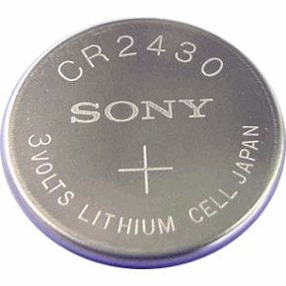
What is Bluetooth Low Energy?
Bluetooth low energy is a NEW, open, short range radio technology
Blank sheet of paper design
Different to Bluetooth classic (BR/EDR)
Optimized for ultra low power
Enable coin cell battery use cases
< 20mA peak current
< 5 uA average current

Slide 25
Basic Concepts of Bluetooth 4.0
Everything is optimized for lowest power consumption
Short packets reduce TX peak current
Short packets reduce RX time
Less RF channels to improve discovery and connection time
Simple state machine
Single protocol
Etc.

Slide 26
Bluetooth low energy factsheet
Range: | ~ 150 meters open field
Output Power: | ~ 10 mW (10dBm)
Max Current: | ~ 15 mA
Latency: | 3 ms
Topology: | Star
Connections: | > 2 billion
Modulation: | GFSK @ 2.4 GHz
Robustness: | Adaptive Frequency Hopping, 24 bit CRC
Security: | 128bit AES CCM
Sleep current: | ~ 1μA
Modes: | Broadcast, Connection, Event Data Models, Reads, Writes

Slide 27
Bluetooth low energy factsheet #2
Data Throughput
For Bluetooth low energy, data throughput is not a meaningful parameter. It does not support streaming.
It has a data rate of 1Mbps, but is not optimized for file transfer.
It is designed for sending small chunks of data (exposing state)

Slide 28
Bluetooth low energy factsheet #2
BLE (Bluetooth Low Energy) is wireless PAN technology designed and maintained by Bluetooth Special Interest Group (SIG). There are various versions of bluetooth. The version 4.2 and above is referred as BLE. The latest in the series are v5.0 and v5.1. BLE specifications are intended to reduce power consumption and cost of devices while maintaining coverage range. BLE is known as "Bluetooth Smart" where as previous version is known as "bluetooth classic".
BLE is not backward compatible with BR/EDR protocols.
BLE uses 2.4 GHz ISM frequency band either in dual mode or single mode. Dual mode supports both bluetooth classic and low energy peripherals.
All BLE devices use the GATT profile (Generic Attribute Profile). The GATT protocol provides series of commands for the client to discover information about BLE server.
The BLE protocol stack architecture consists of two parts viz. controller and host. Both are interfaced using HCI (Host to Controller Interface). Any profiles and applications run on top of GAP & GATT protocol layers.

Slide 29
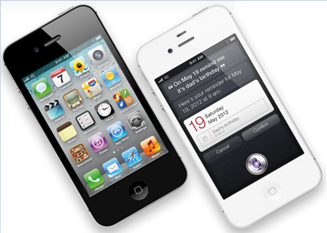

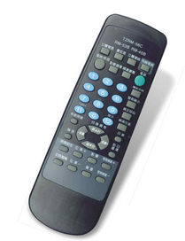
Device Modes
Dual Mode
Bluetooth BR/EDR and LE
Used anywhere that BR/EDR is used today
Single Mode
Implements only Bluetooth low energy
Will be used in new devices / applications

Slide 30
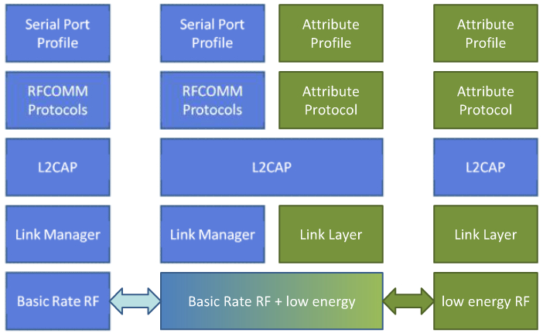
Device Modes
Dual mode + single modes
BR/EDR stack
Dual-mode stack
Single-mode stack

Slide 31
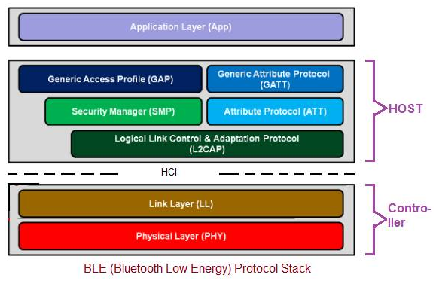
Bluetooth Low Energy Architecture

Slide 32
Physical Layer
2.4 GHz ISM band
1Mbps GFSK
Larger modulation index than Bluetooth BR (which means better range)
40 Channels on 2 MHz spacing
The transmitter uses GFSK modulation and operates at unlicensed 2.4 GHz frequency band.
Using this PHY layer, BLE offers data rates of 1 Mbps (Bluetooth v4.2)/2 Mbps (Bluetooth v5.0).
It uses frequency hopping transceiver.
Two modulation schemes are specified to deliver 1 Msym/s and 2 Msym/s.
Two PHY layer variants are specified viz. uncoded and coded. A Time Division Duplex (TDD) topology is employed in both of the PHY modes.

Slide 33
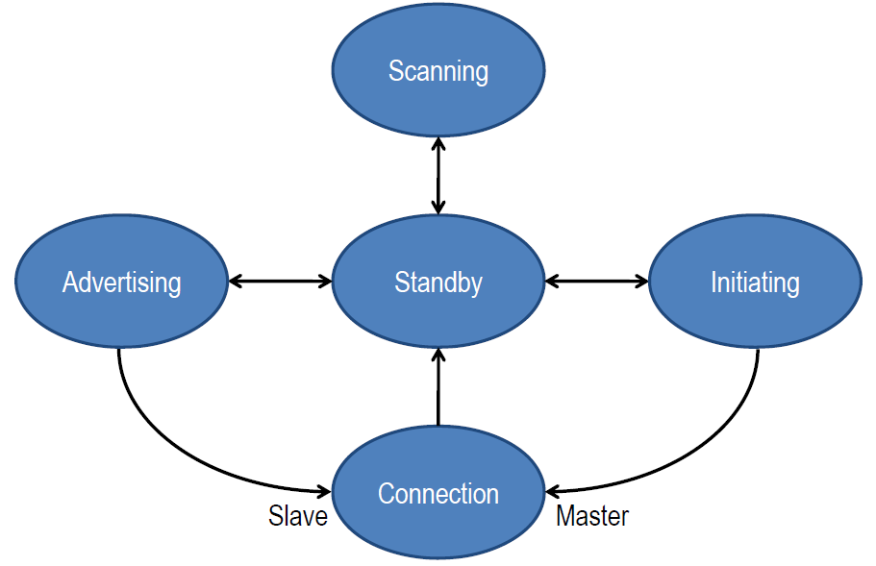
Link Layer
Link Layer state machine
This layer sits above the Physical layer. It is responsible for advertising, scanning, and creating/maintaining connections. The role of BLE devices changes in peer to peer (i.e. Unicast) or broadcast modes. The common roles are Advertiser/Scanner (Initiator), Slave/Master or Broadcaster/Observer. Link layer states are defined in the figure below.

Slide 34
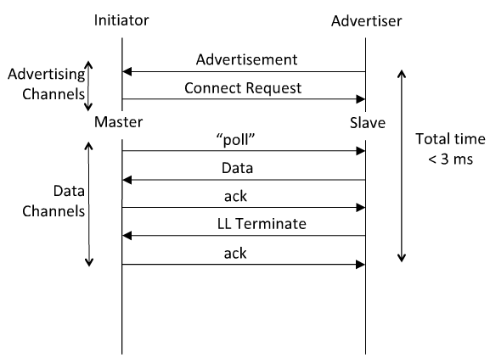
Link Layer Connection
Very low latency connection

Slide 35
Bluetooth Low Energy Architecture
• HCI : It provides communication between controller and host through standard interface types. This HCI layer can be implemented either using API or by interfaces such as UART/SPI/USB. Standard HCI commands and events are defined in the bluetooth specifications. • L2CAP :This layer offers data encapsulation services to upper layers. This allows logical end to end data communication. • SMP :This security Manager layer provides methods for device pairing and key distributions. It offers services to other protocol stack layers in order to securely connect and exchange data between BLE devices.

Slide 36
Bluetooth Low Energy Architecture
• GAP : This layer directly interfaces with application layer and/or profiles on it. It handles device discovery and connection related services for BLE device. It also takes care of initiation of security features. • GATT : This layer is service framework which specifies sub-procedures to use ATT. Data communications between two BLE devices are handled through these sub-procedures. The applications and/or profiles will use GATT directly. • ATT : This layer allows BLE device to expose certain pieces of data or attributes.

Slide 37
Bluetooth Low Energy Architecture
Application Layer : • The BLE protocol stack layers interact with applications and profiles as desired. Application interoperability in the Bluetooth system is accomplished by Bluetooth profiles. • The profile defines the vertical interactions between the layers as well as the peer-to-peer interactions of specific layers between devices. • A profile composed of one or more services to address particular use case. A service consists of characteristics or references to other services. • Any profiles/applications run on top of GAP/GATT layers of BLE protocol stack. It handles device discovery and connection related services for the BLE device.

Slide 38
What are the USE CASES planned for BT 4.0?
Proximity
Time
Emergency
Network availability
Personal User Interface
Simple remote control
Browse over Bluetooth
Temperature Sensor
Humidity Sensor
HVAC
Generic I/O (automation)
Battery status
Heart rate monitor
Physical activity monitor
Blood glucose monitor
Cycling sensors
Pulse Oximeter
Body thermometer

Slide 39

Example use: proximity
It can enable proximity detection
I’m in the car
I’m in the office
I’m in the meeting room
I’m in the movie theater
It can enable presence detection
Turn the lights on when I walk around the house
Automatically locks the door when I leave home
Turn the alarm off if I’m already awake

Slide 40


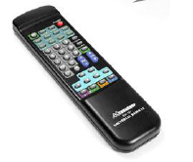
Everyday objects can become sensors
My pulse is …
My blood glucose is …
My temperature is …
… and monitor things unobtrusively

Slide 41
LoRaWAN
A new set of wireless technologies known as Low-Power Wide-Area (LPWA) has
Particularly well adapted for long-range and battery-powered endpoints.
An unlicensed-band LPWA technology, known as LoRaWAN

Slide 42
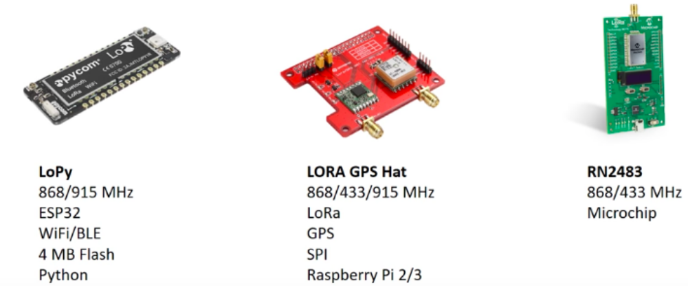
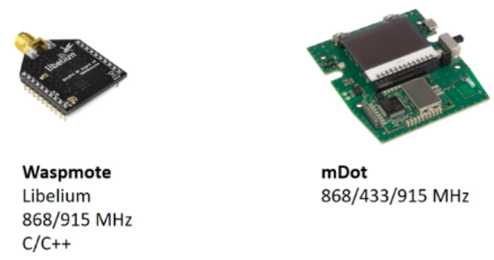

Slide 43
LoRaWAN

Slide 44
LoRaWAN
Deployed in a star-of-stars topology
Have base stations relaying the data between sensor nodes & network server
Communication between sensor nodes & BS goes over the wireless channel utilizing LoRa physical layer, whilst the connection between gateways & central server are over a backbone IP-based network
End Nodes transmit directly to all gateways within range, using LoRa
Gateways relay messages between end-devices & central network server using IP

Slide 45
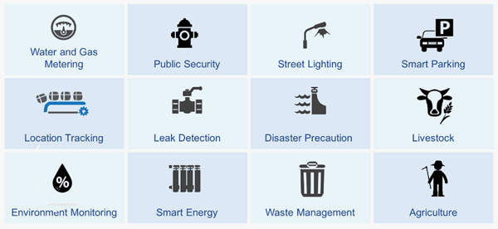
LoRa Use Cases

Slide 46
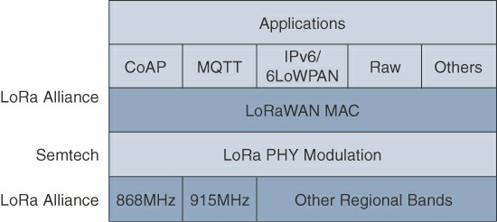
LoRaWAN Layers

Slide 47
Physical Layer
Semtech LoRa modulation is based on chirp spread spectrum modulation, which trades a lower data rate for receiver sensitivity to significantly increase the communication distance.
It allows demodulation below the noise floor, offers robustness to noise and interference, and manages a single channel occupation by different spreading factors.
This enables LoRa devices to receive on multiple channels in parallel.

Slide 48
Frequency bands
433 MHz, 779–787 MHz, 863–870 MHz, and 902–928 MHz,
as well as regional profiles for a subset of the 902–928 MHz bandwidth.
For example, Australia utilizes 915–928 MHz frequency bands, while
South Korea uses 920–923 MHz and
Japan uses 920–928 MHz.

Slide 49
Spreading factor
An important feature of LoRa is its ability to handle various data rates via the spreading factor.
Devices with a low spreading factor (SF) achieve less distance in their communications but transmit at faster speeds, resulting in less airtime.
A higher SF provides slower transmission rates but achieves a higher reliability at longer distances.

Slide 50
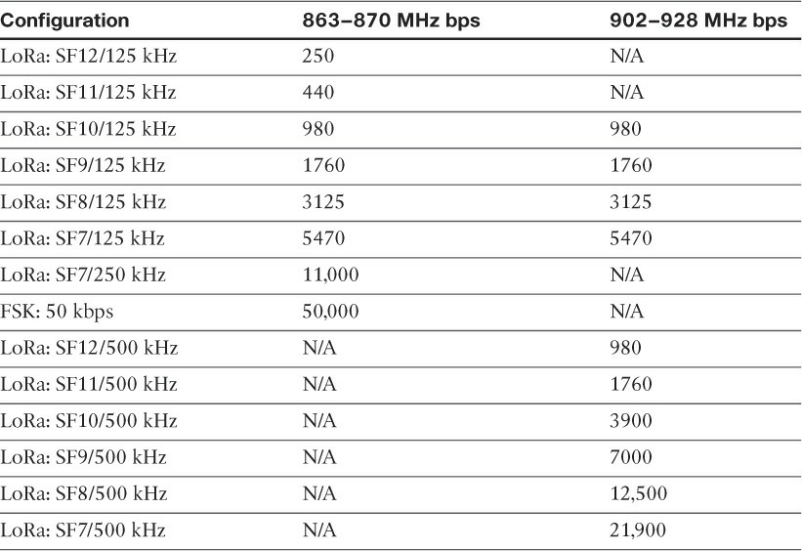
LoRaWAN Data Rate Example

Slide 51
MAC Layer
The LoRaWAN specification documents three classes of LoRaWAN devices:
Class A: This class is the default implementation. Optimized for battery-powered nodes, it allows bidirectional communications, where a given node is able to receive downstream traffic after transmitting. Two receive windows are available after each transmission.
Class B: This class was designated “experimental” in LoRaWAN 1.0.1 until it can be better defined. A Class B node or endpoint should get additional receive windows compared to Class A, gateways must be synchronized through a beaconing process.
Class C: This class is particularly adapted for powered nodes. This classification enables a node to be continuously listening by keeping its receive window open when not transmitting.

Slide 52
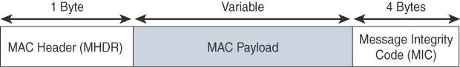
High-Level LoRaWAN MAC Frame Format
LoRaWAN messages, either uplink or downlink, have a PHY payload composed of a 1-byte MAC header, a variable-byte MAC payload, and a MIC that is 4 bytes in length. The MAC payload size depends on the frequency band and the data rate, ranging from 59 to 230 bytes for the 863–870 MHz band and 19 to 250bytes for the 902–928 MHz band. Figure shows a high-level LoRaWAN MAC frame format.

Slide 53
Topology
LoRaWAN topology is often described as a “star of stars” topology.
Consists of endpoints exchanging packets through gateways acting as bridges, with a central LoRaWAN network server.
Gateways connect to the backend network using standard IP connections, and endpoints communicate directly with one or more gateways.

Slide 54
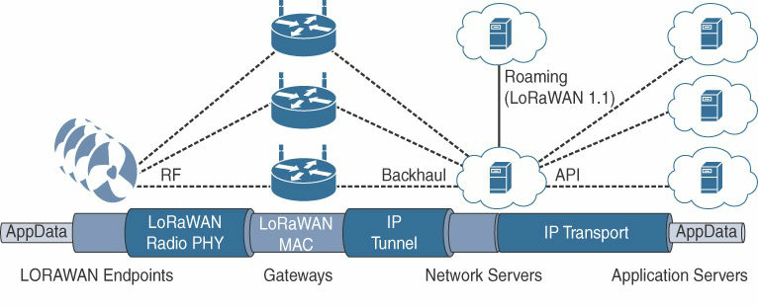
LoRaWAN Topology

Slide 55
LoRaWAN - Topology
A “star of stars” topology
The infrastructure consists of endpoints exchanging packets through gateways acting as bridges, with a central LoRaWAN network server.
Gateways connect to the backend network using standard IP connections, and endpoints communicate directly with one or more gateways
LoRaWAN gateways act as bridges that relay between endpoints and the network servers.
Multiple gateways can receive and transport the same packets. When duplicate packets are received, de-duplication is a function of the network server.
The LoRaWAN network server manages the data rate and radio frequency (RF) of each endpoint through the adaptive data rate (ADR) algorithm.

Slide 56
LoRaWAN Topology
LoRaWAN endpoints transport their selected application data over the LoRaWAN MAC layer on top of one of the supported PHY layer frequency bands.
The application data is contained in upper protocol layers.
These upper layers could just be raw data on top of the LoRaWAN MAC layer, or the data could be stacked in multiple protocols.
For example, upper-layer protocols,
ZigBee Control Layer (ZCL), Constrained Application Protocol (CoAP), Message Queuing Telemetry Transport (MQTT), or with/without IPv6/6LoWPAN layer.

Slide 57
Security
Security in a LoRaWAN deployment applies to different components of the architecture.
LoRaWAN endpoints must implement two layers of security,
protecting communications and
data privacy across the network.

Slide 58
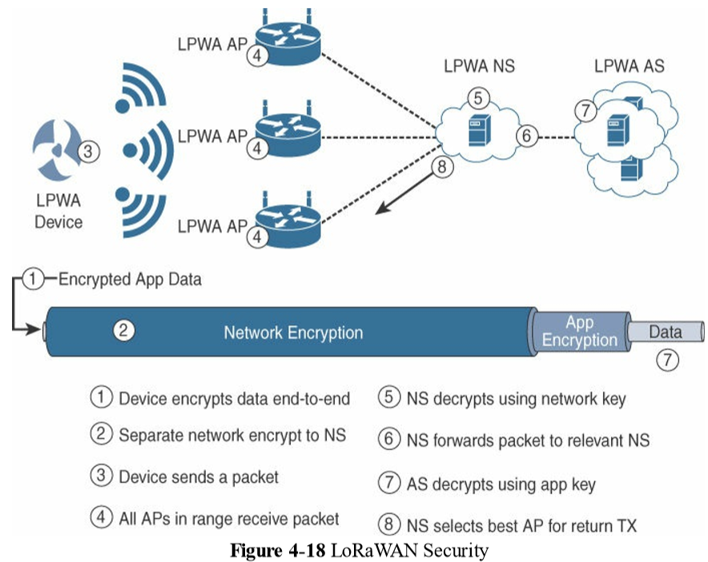
LoRaWAN - Security

Slide 59
LoRaWAN - Security
LoRaWAN endpoints must implement two layers of security,
Protecting communications
Data privacy across the network.

Slide 60
LoRaWAN - Security
Protecting communications
Also called “network security” but applied at the MAC layer,
guarantees the authentication of the endpoints by the LoRaWAN network server.
It protects LoRaWAN packets by performing encryption based on AES.
Each endpoint implements a network session key (NwkSKey), used by both itself and the LoRaWAN network server.
The NwkSKey ensures data integrity through computing and checking the MIC of every data message as well as encrypting and decrypting MAC-only data message payloads.

Slide 61
LoRaWAN - Security
Data privacy :
An application session key (AppSKey), which performs encryption and decryption functions between the endpoint and its application server.
It computes and checks the application-level MIC, if included.
This ensures that the LoRaWAN service provider does not have access to the application payload if it is not allowed that access.
Endpoints receive their AES-128 application key (AppKey) from the application owner.
This key is most likely derived from an application-specific root key exclusively known to and under the control of the application provider.

Slide 62
LoRaWAN - Security
LoRaWAN endpoints attached to a LoRaWAN network must get registered and authenticated.
This can be achieved through one of the two join mechanisms:
Activation by personalization (ABP):
Endpoints don’t need to run a join procedure as their individual details, including DevAddr and the NwkSKey and AppSKey session keys, are preconfigured and stored in the end device. This same information is registered in the LoRaWAN network server.
Over-the-air activation (OTAA):
Endpoints are allowed to dynamically join a particular LoRaWAN network after successfully going through a join procedure. The join procedure must be done every time a session context is renewed. During the join process, which involves the sending and receiving of MAC layer join request and join accept messages, the node establishes its credentials with a LoRaWAN network server, exchanging its globally unique DevEUI, AppEUI, and AppKey. The AppKey is then used to derive the session NwkSKey and AppSKey keys.

Slide 63
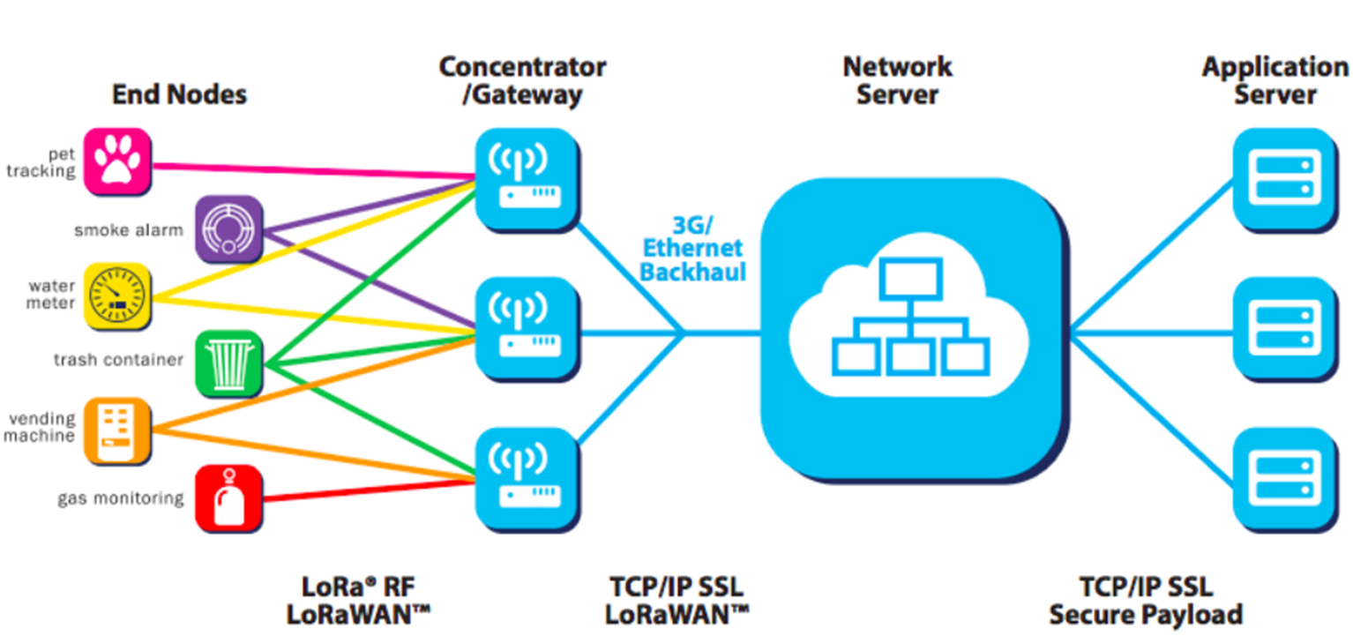
End Nodes are LoRa embedded sensors
End Nodes typically have:
Sensors: detect the changing parameter eg. temperature, humidity, accelerometer, gps)
LoRa transponder: transmit signals over LoRa patented radio transmission method
optionally a micro-controller (with on board Memory)
LoRa sensors can transmit signals over distances from 1km — 10km

Slide 64
Gateways
always connected to power source
connect to network server via standard IP connections
act as a transparent bridge, simply converting RF packets to IP packets & vice versa.
Network servers :
cloud based platform solutions, e.g., The Things Network (TTN) or LoRIOT
connect to gateways & de-dup data packets, and then routes it to the relevant application
can be used for both uplink (i.e. sensor to application) or downlink (i.e. application to sensor) communication

Slide 65
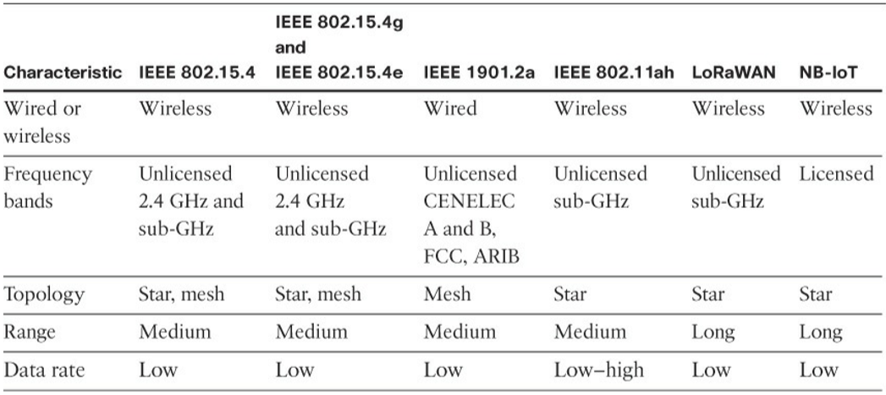
Main Characteristics of different Access Technologies

Slide 66
Network Layer
Network layer connectivity, which is commonly referred to as Layer 3.
The network transport layer sublayer that is part of the communications network layer.
IP Versions
Transitioning the Internet from IP version 4 to IP version 6. The main driving force has been the lack of address space in IPv4 as the Internet has grown.
IPv6 has a much larger range of addresses that should not be exhausted for the foreseeable future.
Today, both versions of IP run over the Internet, but most traffic is still IPv4 based.

Slide 67
IP Versions
Internet of Things support both IPv4 and IPv6 versions concurrently.
Techniques such as tunneling and translation need to be employed in IoT solutions to ensure interoperability between IPv4 and IPv6.
A variety of factors dictate whether IPv4, IPv6, or both can be used in an IoT solution.
Most often these factors include a legacy protocol or technology that supports only IPv4.
Newer technologies and protocols almost always support both IP versions

Slide 68
Main factors applicable to IPv4 and IPv6 support in an IoT solution
Application Protocol:
IoT devices implementing Ethernet or Wi-Fi interfaces can communicate over both IPv4 and IPv6, but the application protocol may dictate the choice of the IP version.
For example, SCADA protocols such as DNP3/IP (IEEE 1815), Modbus TCP, or the IEC 60870-5-104 standards are specified only for IPv4.
For IoT devices with application protocols defined by the IETF, such as HTTP/HTTPS, CoAP, MQTT, and XMPP, both IP versions are supported

Slide 69
Cellular Provider and Technology:
IoT devices with cellular modems are dependent on the generation of the cellular technology as well as the data services offered by the provider.
For the first three generations of data services—GPRS, Edge, and 3G—IPv4 is the base protocol version.
Consequently, if IPv6 is used with these generations, it must be tunneled over IPv4.
On 4G/LTE networks, data services can use IPv4 or IPv6 as a base protocol, depending on the provider.

Slide 70
Serial Communications:
Many legacy devices in certain industries, such as manufacturing and utilities, communicate through serial lines. Data is transferred using either proprietary or standardsbased protocols, such as DNP3, Modbus, or IEC 60870-5-101.
Encapsulation of serial protocols over IP leverages mechanisms such as raw socket TCP or UDP. While raw socket sessions can run over both IPv4 and IPv6, current implementations are mostly available for IPv4 only.

Slide 71
Constrained Nodes
Depending on its functions in a network, a “thing” architecture may or may not offer similar characteristics.
Another limit is that this network protocol stack on an IoT node may be required to communicate through an unreliable path.
Finally, power consumption is a key characteristic of constrained nodes. Many IoT devices are battery powered, with lifetime battery requirements varying from a few months to 10+ years

Slide 72
IoT Constrained nodes
Devices that are very constrained in resources, may communicate infrequently to transmit a few bytes, and may have limited security and management capabilities:
This drives the need for the IP adaptation model, where nodes communicate through gateways and proxies.
Devices with enough power and capacities to implement a stripped-down IP stack or non-IP stack:
In this case, you may implement either an optimized IP stack and directly communicate with application servers (adoption model) or go for an IP or non-IP stack and communicate through gateways and proxies (adaptation model).

Slide 73
Devices that are similar to generic PCs in terms of computing and power resources but have constrained networking capacities, such as bandwidth:
These nodes usually implement a full IP stack (adoption model), but network design and application behaviors must cope with the bandwidth constraints.

Slide 74
Constrained Networks
Network bandwidth capacity was restrained due to technical limitations. Connections often depended on low-speed modems for transferring data. However, these low-speedconnections demonstrated that IP could run over low-bandwidth networks.
Networking has seen the emergence of high-speed infrastructures. However, high-speed connections are not usable by some IoT devices in the last mile.

Slide 75
implementation of technologies with low bandwidth,
limited distance and bandwidth due to regulated transmit power, and
lack of or limited network services
A constrained network can have high latency and a high potential for packet loss.

Slide 76
Constrained Networks
Constrained networks are often referred to as low-power and lossy networks (LLNs).
Lossy in this context refers to network unreliability that is caused by disruptions in the data flow or packet loss.
Constrained networks have unique characteristics and requirements.
In contrast with typical IP networks, where highly stable and fast links are available, constrained networks are limited by low-power, low bandwidth links (wireless and wired).
They operate between a few kbps and a few hundred kbps and may utilize a star, mesh, or combined network topologies, ensuring proper operations

Slide 77
Packet delivery rate (PDR) to oscillate between low and high percentages.
Large bursts of unpredictable errors and even loss of connectivity at times may occur.
These behaviors can be observed on both wireless and narrowband power-line communication links, where packet delivery variation may fluctuate greatly during the course of a day.
Due to the low bandwidth, a constrained network that overreacts can lead to a network collapse.
This in turn has led various standards organizations to work on optimizing protocols for IoT

Slide 78
Optimizing IP for IoT
While the Internet Protocol is key for a successful Internet of Things, constrained nodes and constrained networks mandate optimization at various layers and on multiple protocols of the IP architecture.

Slide 79
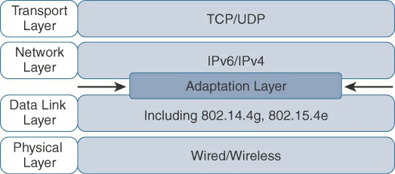
Optimizing IP for IoT Using an Adaptation Layer
From 6LoWPAN to 6Lo:
In the IP architecture, the transport of IP packets over any given Layer 1 (PHY) and Layer 2 (MAC) protocol must be defined and documented. The model for packaging IP into lower-layer protocols is often referred to as an adaptation layer

Slide 80
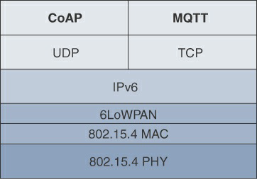
IoT Application Layer Protocols
IoT industry is working on new lightweight protocols that are better suited to large numbers of constrained nodes and networks.
Two of the most popular protocols are CoAP and MQTT.
Example of a High-Level IoT Protocol Stack for CoAP and MQTT

Slide 81
CoAP
Constrained Application Protocol (CoAP) resulted from the IETF Constrained RESTful Environments (CoRE) working group’s efforts to develop a generic framework for resource-oriented applications targeting constrained nodes and networks.
The CoAP messaging model is primarily designed to facilitate the exchange of messages over UDP between endpoints, including the secure transport protocol Datagram Transport Layer Security (DTLS).

Slide 82
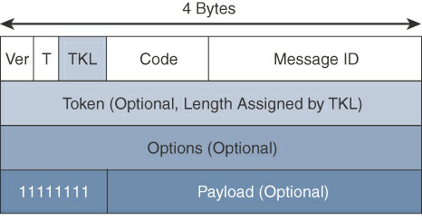
CoAP message format
Composed of a short fixed-length Header field (4 bytes), a variable-length but mandatory Token field (0–8 bytes), Options fields if necessary, and the Payload field.

Slide 83
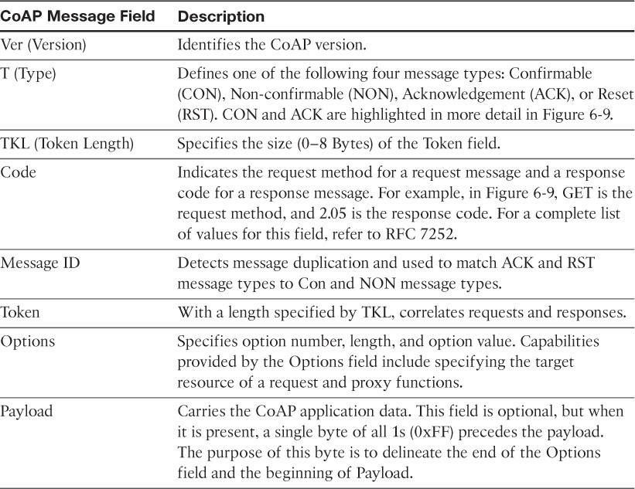
CoAP Message Fields

Slide 84
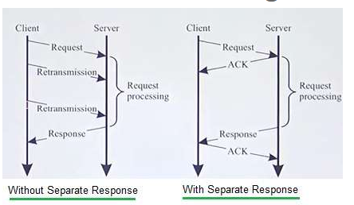
CoAP Protocol Message Exchanges
There are two modes in which CoAP protocol messages get exchanged between CoAP client and CoAP server viz. without separate response and with separate response.
With separate response, server notifies client about receipt of the request message. This will increase processing time but help in avoiding unnecessary retransmissions.
CoAP IoT is unreliable protocol due to use of UDP. Hence CoAP messages reach unordered or will get lost when they arrive at destination.
To make CoAP as reliable protocol, stop and wait with exponential backoff retransmission feature is incorporated in it. Duplicate detection is also introduced.

Slide 85
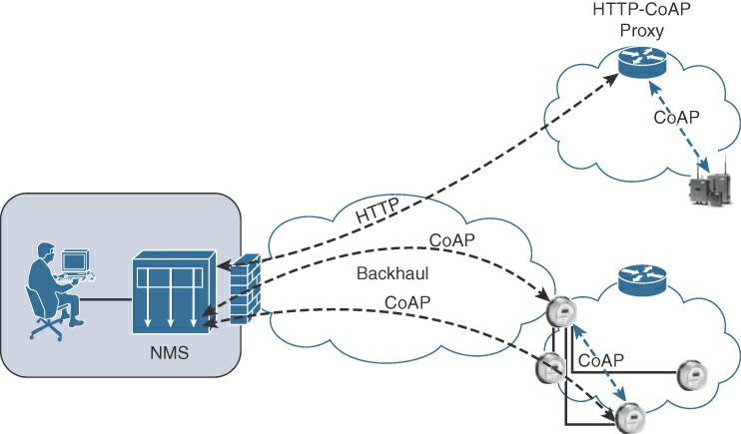
CoAP Communications in IoT Infrastructures

Slide 86
Connections can be between devices located on the same or different constrained networks or between devices and generic Internet or cloud servers, all operating over IP.
As both HTTP and CoAP are IP-based protocols, the proxy function can be located practically anywhere in the network, not necessarily at the border between constrained and non-constrained networks.

Slide 87
CoAP is based on the REST architecture, but with a “thing” acting as both the client and the server.
Through the exchange of asynchronous messages, a client requests an action via a method code on a server resource.
A uniform resource identifier (URI) localized on the server identifies this resource.
The server responds with a response code that may include a resource representation.
The CoAP request/response semantics include the methods GET, POST, PUT, and DELETE.

Slide 88
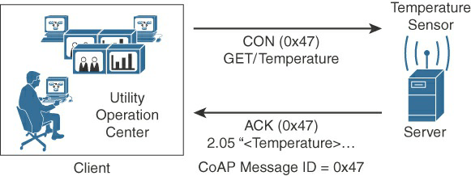
CoAP Reliable Transmission Example

Slide 89
CoAP Protocol: Step-by-Step Guide
The main features of CoAP protocols are:
Web protocol used in M2M with constrained requirements
Asynchronous message exchange
Low overhead and very simple to parse
URI and content-type support
Proxy and caching capabilities

Slide 90
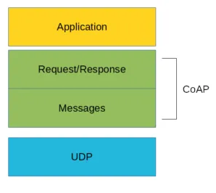
CoAP Protocol: Step-by-Step Guide
From the abstraction protocol layer, CoAP can be represented as:
As you can see there are two different layers that make CoAp protocol:
Messages and Request/Response. The Messages layer deals with UDP and with asynchronous messages. The Request/Response layer manages request/response interaction based on request/response messages.
CoAP supports four different message types:
Confirmable
Non-confirmable
Acknowledgment
Reset

Slide 91
CoAP Protocol: Step-by-Step Guide
CoAp protocol, structure is useful to define some terms that we will use later:
Endpoint: An entity that participates in the CoAP protocol. Usually, an Endpoint is identified with a host
Sender: The entity that sends a message
Recipient: The destination of a message
Client: The entity that sends a request and the destination of the response
Server: The entity that receives a request from a client and sends back a response to the client

Slide 92
CoAP Protocol: Step-by-Step Guide
CoAP protocol uses two kinds of messages:
Confirmable message
Non-confirmable message
A confirmable message is a reliable message. When exchanging messages between two endpoints, these messages can be reliable. In CoAP, a reliable message is obtained using a Confirmable message (CON). Using this kind of message, the client can be sure that the message will arrive at the server. A Confirmable message is sent again and again until the other party sends an acknowledge message (ACK). The ACK message contains the same ID of the confirmable message (CON).

Slide 93
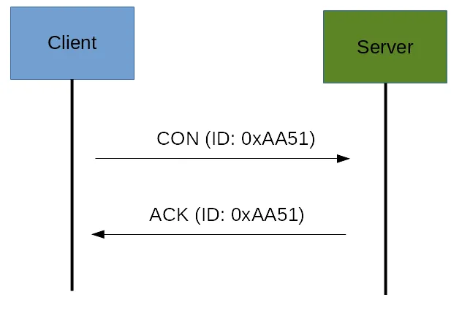
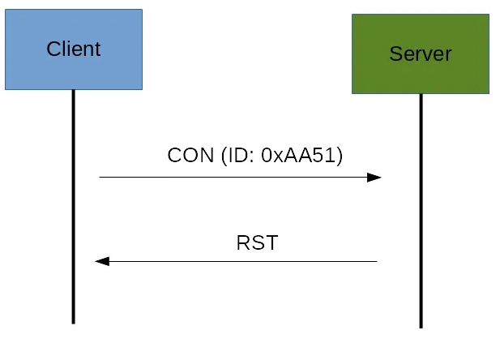
CoAP Protocol: Step-by-Step Guide
Confirmable message
If the server has troubles managing the incoming request, it can send back a Rest message (RST) instead of the Acknowledge message (ACK):

Slide 94
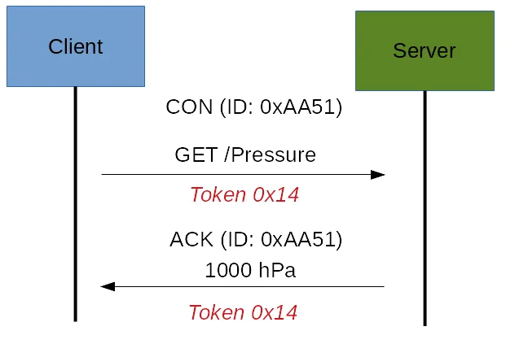
CoAP Protocol: Step-by-Step Guide
Non-confirmable (NON) messages.
These are messages that don’t require an Acknowledge by the server. They are unreliable messages or in other words messages that do not contain critical information that must be delivered to the server. To this category belongs messages that contain values read from sensors.
Even if these messages are unreliable, they have a unique ID.
CoAP message, there is a Token. The Token is different from the Message-ID and it is used to match the request and the response.

Slide 95
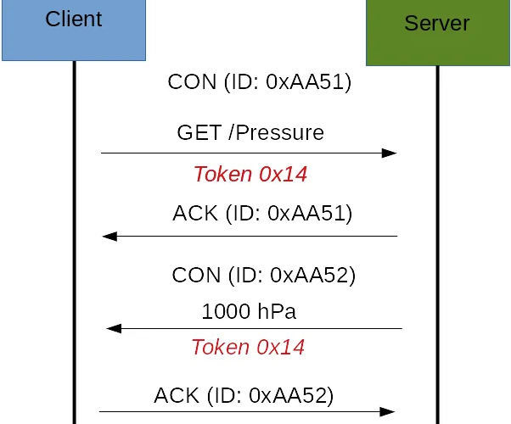
CoAP Protocol: Step-by-Step Guide
If the server can’t answer to the request coming from the client immediately, then it sends an Acknowledge message with an empty response. As soon as the response is available, then the server sends a new Confirmable message to the client containing the response. At this point, the client sends back an Acknowledge message:
If the request coming from the client is carried using a NON-confirmable message, then the server answer using a NON-confirmable message.

Slide 96
Message Queuing Telemetry Transport (MQTT)
A reliable, lightweight, and cost-effective protocol to monitor and control a large number of sensors and their data from a central server location, as typically used by the oil and gas industries.
Standardized by the Organization for the Advancement of Structured Information Standards (OASIS).
Considering the harsh environments in the oil and gas industries, an extremely simple protocol with only a few options was designed, with considerations for constrained nodes, unreliable WAN backhaul communications, and bandwidth constraints with variable latencies.

Slide 97
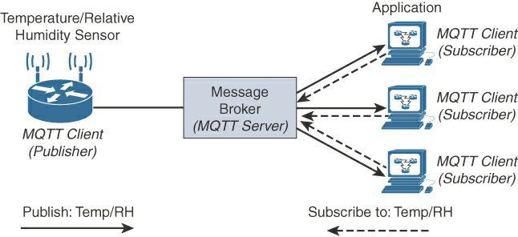
MQTT Publish/Subscribe Framework
Message:
When the message is transmitted over the network, then the message contains the following parameters:
Payload data
Quality of Service (QoS)
Collection of Properties
Topic Name
The clients subscribe to the topics to publish and receive messages.
Publish: When the client sends the data to the server, then we call this operation as a publish.
Subscribe: When the client receives the data from the server, then we call this operation a subscription.

Slide 98
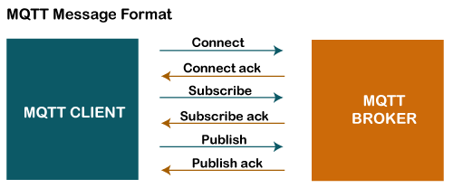
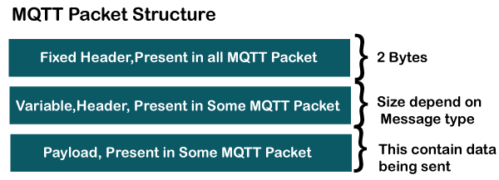
MQTT Publish/Subscribe Framework
Server accepts the network connection from the client, accepts the messages from the client, processes the subscribe and unsubscribe requests, forwards the application messages to the client, and closes the network connection from the client.

Slide 99
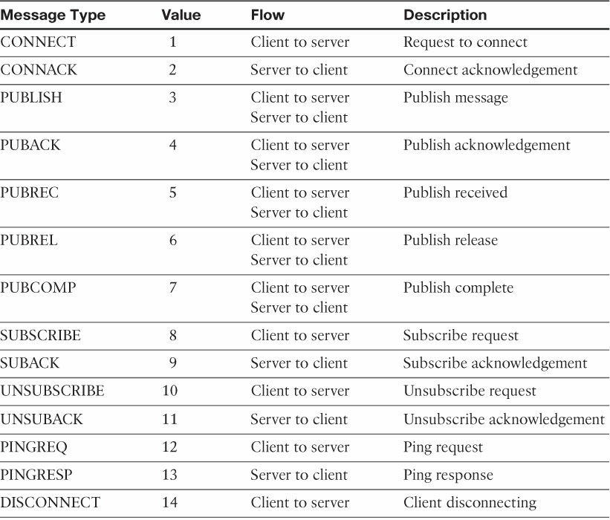
MQTT Message Types

Slide 100
The next field in the MQTT header is DUP (Duplication Flag). This flag, when set, allows the client to notate that the packet has been sent previously, but an acknowledgement was not received.
The QoS header field allows for the selection of three different QoS levels.
The next field is the Retain flag. Only found in a PUBLISH message.
The Retain flag notifies the server to hold onto the message data. This allows new subscribers to instantly receive the last known value without having to wait for the next update from the publisher.
The last mandatory field in the MQTT message header is Remaining Length. This field specifies the number of bytes in the MQTT packet following this field.

Slide 101
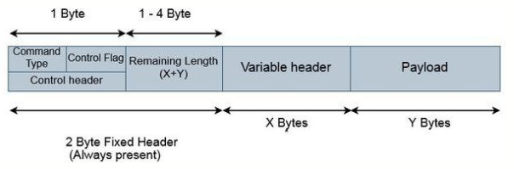
MQTT Packet Format
The MQTT packet consists of 2-byte fixed header + a variable header and a payload. In this first 2-byte fixed header will be always present in all the packets and the other two, variable header and payload are not always present.

Slide 102
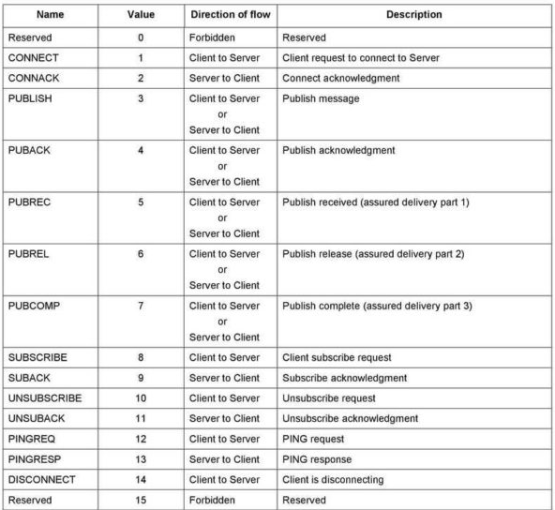
MQTT Packet Format
Command type
Out of the two-byte fixed header, the first byte is the control field. This 8-bit control field Is divided into two 4 bit fields. The first 4 MSB bits are the command type field. E.g. The value of the connect command is 1. That means for connect command the connect type field should be 1 which is 0001. For publish command the value is 3, therefore, the connect type field should be 0011.

Slide 103
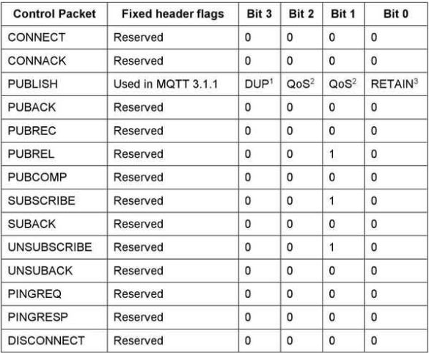
MQTT Packet Format
Control Flag bits
The next 4 bits are the control flag bits and they are used by the publish command for the rest of the commands they are reserved and the value will be 0. For PUBLISH command: 0th bit denotes if the message that is published is retained the message. 1st and 2nd bits are used to select the quality of service if it is 0 or 1 or 2. And the 3rd bit denotes if it is a duplicate message.

Slide 104
MQTT Packet Format
Remaining Length
The second byte of the fixed header contains the remaining length which is, length of variable header + the length of the payload. Remaining length can use up to 4 bytes in which each byte uses 7 bits for the length and the MSB bit being a continuation flag. if the continuation flag bit of a byte is 1, it means the next byte is also part of the remaining length. And if the continuation flag bit is 0, it means that byte is the last one of the remaining length.
E.g. if the variable header length is 10 and the length of the payload is 20, the remaining length should be 30.
Variable header
A variable header is not present in all the MQTT packets. Some MQTT commands or messages use this field to provide additional information or flags and they vary depending on the packet type. A packet identifier is common in most of the packets types. We will discuss in detail the variable header for the CONNECT packet below.

Slide 105
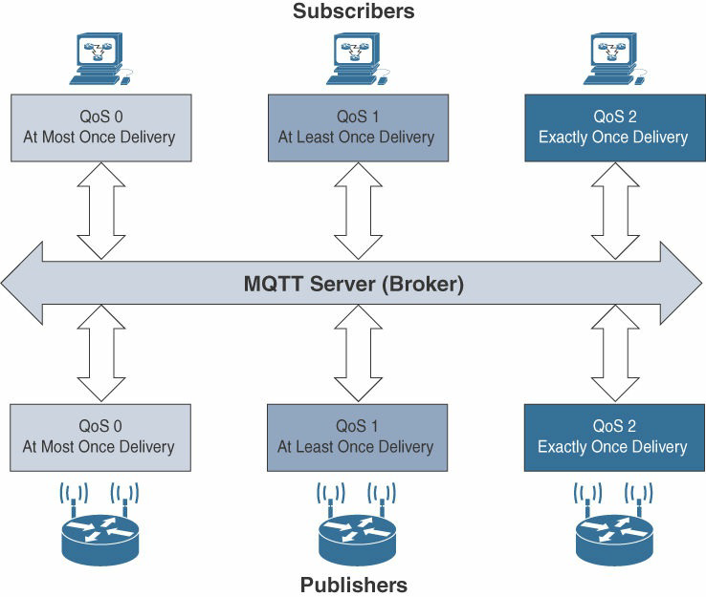
MQTT QoS Flows

Slide 106
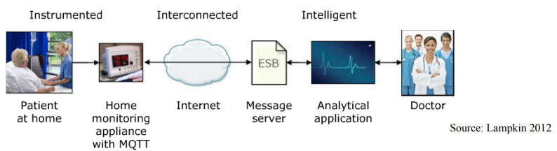
MQTT Application
Home pacemaker monitoring solution
Sensors on patient
Collected by a monitoring equipment in home (broker) using MQTT
Subscribed by a computer in the hospital
Alerts the doctor if anything is out-of-order

Slide 107
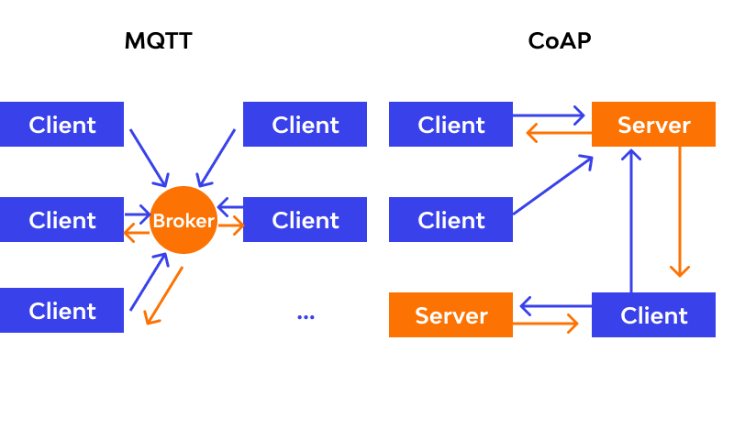
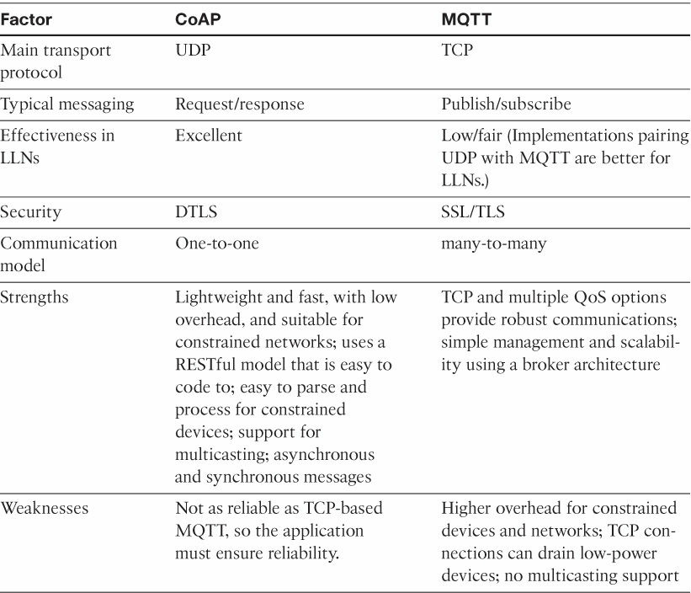
Comparison Between CoAP and MQTT

Slide 108
IoT Communication Models
IoT devices are found everywhere and will enable circulatory intelligence in the future.
For operational perception, it is important and useful to understand how various IoT devices communicate with each other.
Communication models used in IoT have great value. The IoTs allow people and things to be connected any time, any space, with anything and anyone, using any network and any service.
Types of Communication Models :
Request-Response Model
Publish-Subscribe Model
Push-Pull Model
Exclusive Pair Model

Slide 109
Request-Response model
Request-Response is a communication model in which the client sends requests to the server and the server responds to the requests.
When the server receives a request, it decides how to respond, fetches the data, retrieves resource representations, prepares the response, and then sends the response to the client.
Request-Response model is a stateless communication model and each request-response pair is independent of others. Figure 1.7 shows the client-server interactions in the request-response model.

Slide 110
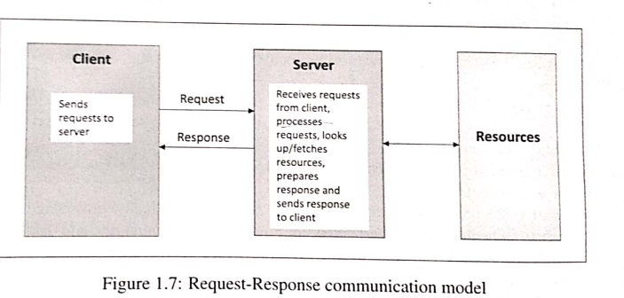
Request-Response model

Slide 111
Publish-Subscribe model
Publish-Subscribe is a communication model that involves publishers, brokers and consumers. Publishers are the source of data.
Publishers send the data to the topics which are managed by the broker. Publishers are not aware of the consumers.
Consumers subscribe to the topics which are managed by the broker.
When the broker receives data for a topic from the publisher, it sends the data to all the subscribed consumers. Figure 1.8 shows the publisher-broker-consumer interactions

Slide 112
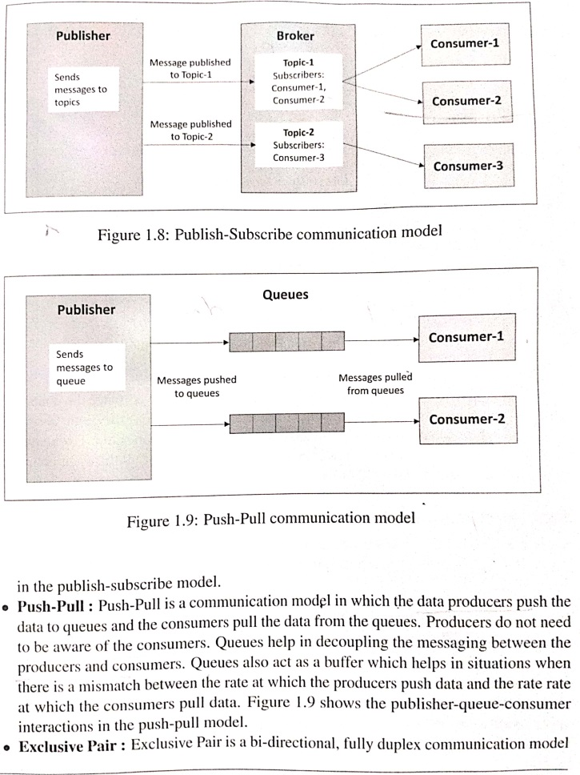
Publish-Subscribe model

Slide 113
Push-Pull model
Push-Pull : Push-Pull is a communication model in which the data producers push the data to queues and the consumers pull the data from the queues.
Producers do not need to be aware of the consumers. Queues help in decoupling the messaging between the producers and consumers.
Queues also act as a buffer which helps in situations when there is a mismatch between the rate at which the producers push data and the rate rate at which the consumers pull data.
Figure 1.9 shows the publisher-queue-consumer interactions in the push-pull model.

Slide 114
Push-Pull model

Slide 115
Exclusive Pair model
Exclusive Pair : Exclusive Pair is a bi-directional, fully duplex communication model that uses a persistent connection between the client and server.
Once the connection is setup it remains open until the client sends a request to close the connection. Client and server can send messages to each other after connection setup.
Exclusive pair is a stateful communication model and the server is aware of all the open connections.
Figure 1.10 shows the client-server interactions in the exclusive pair model.

Slide 116
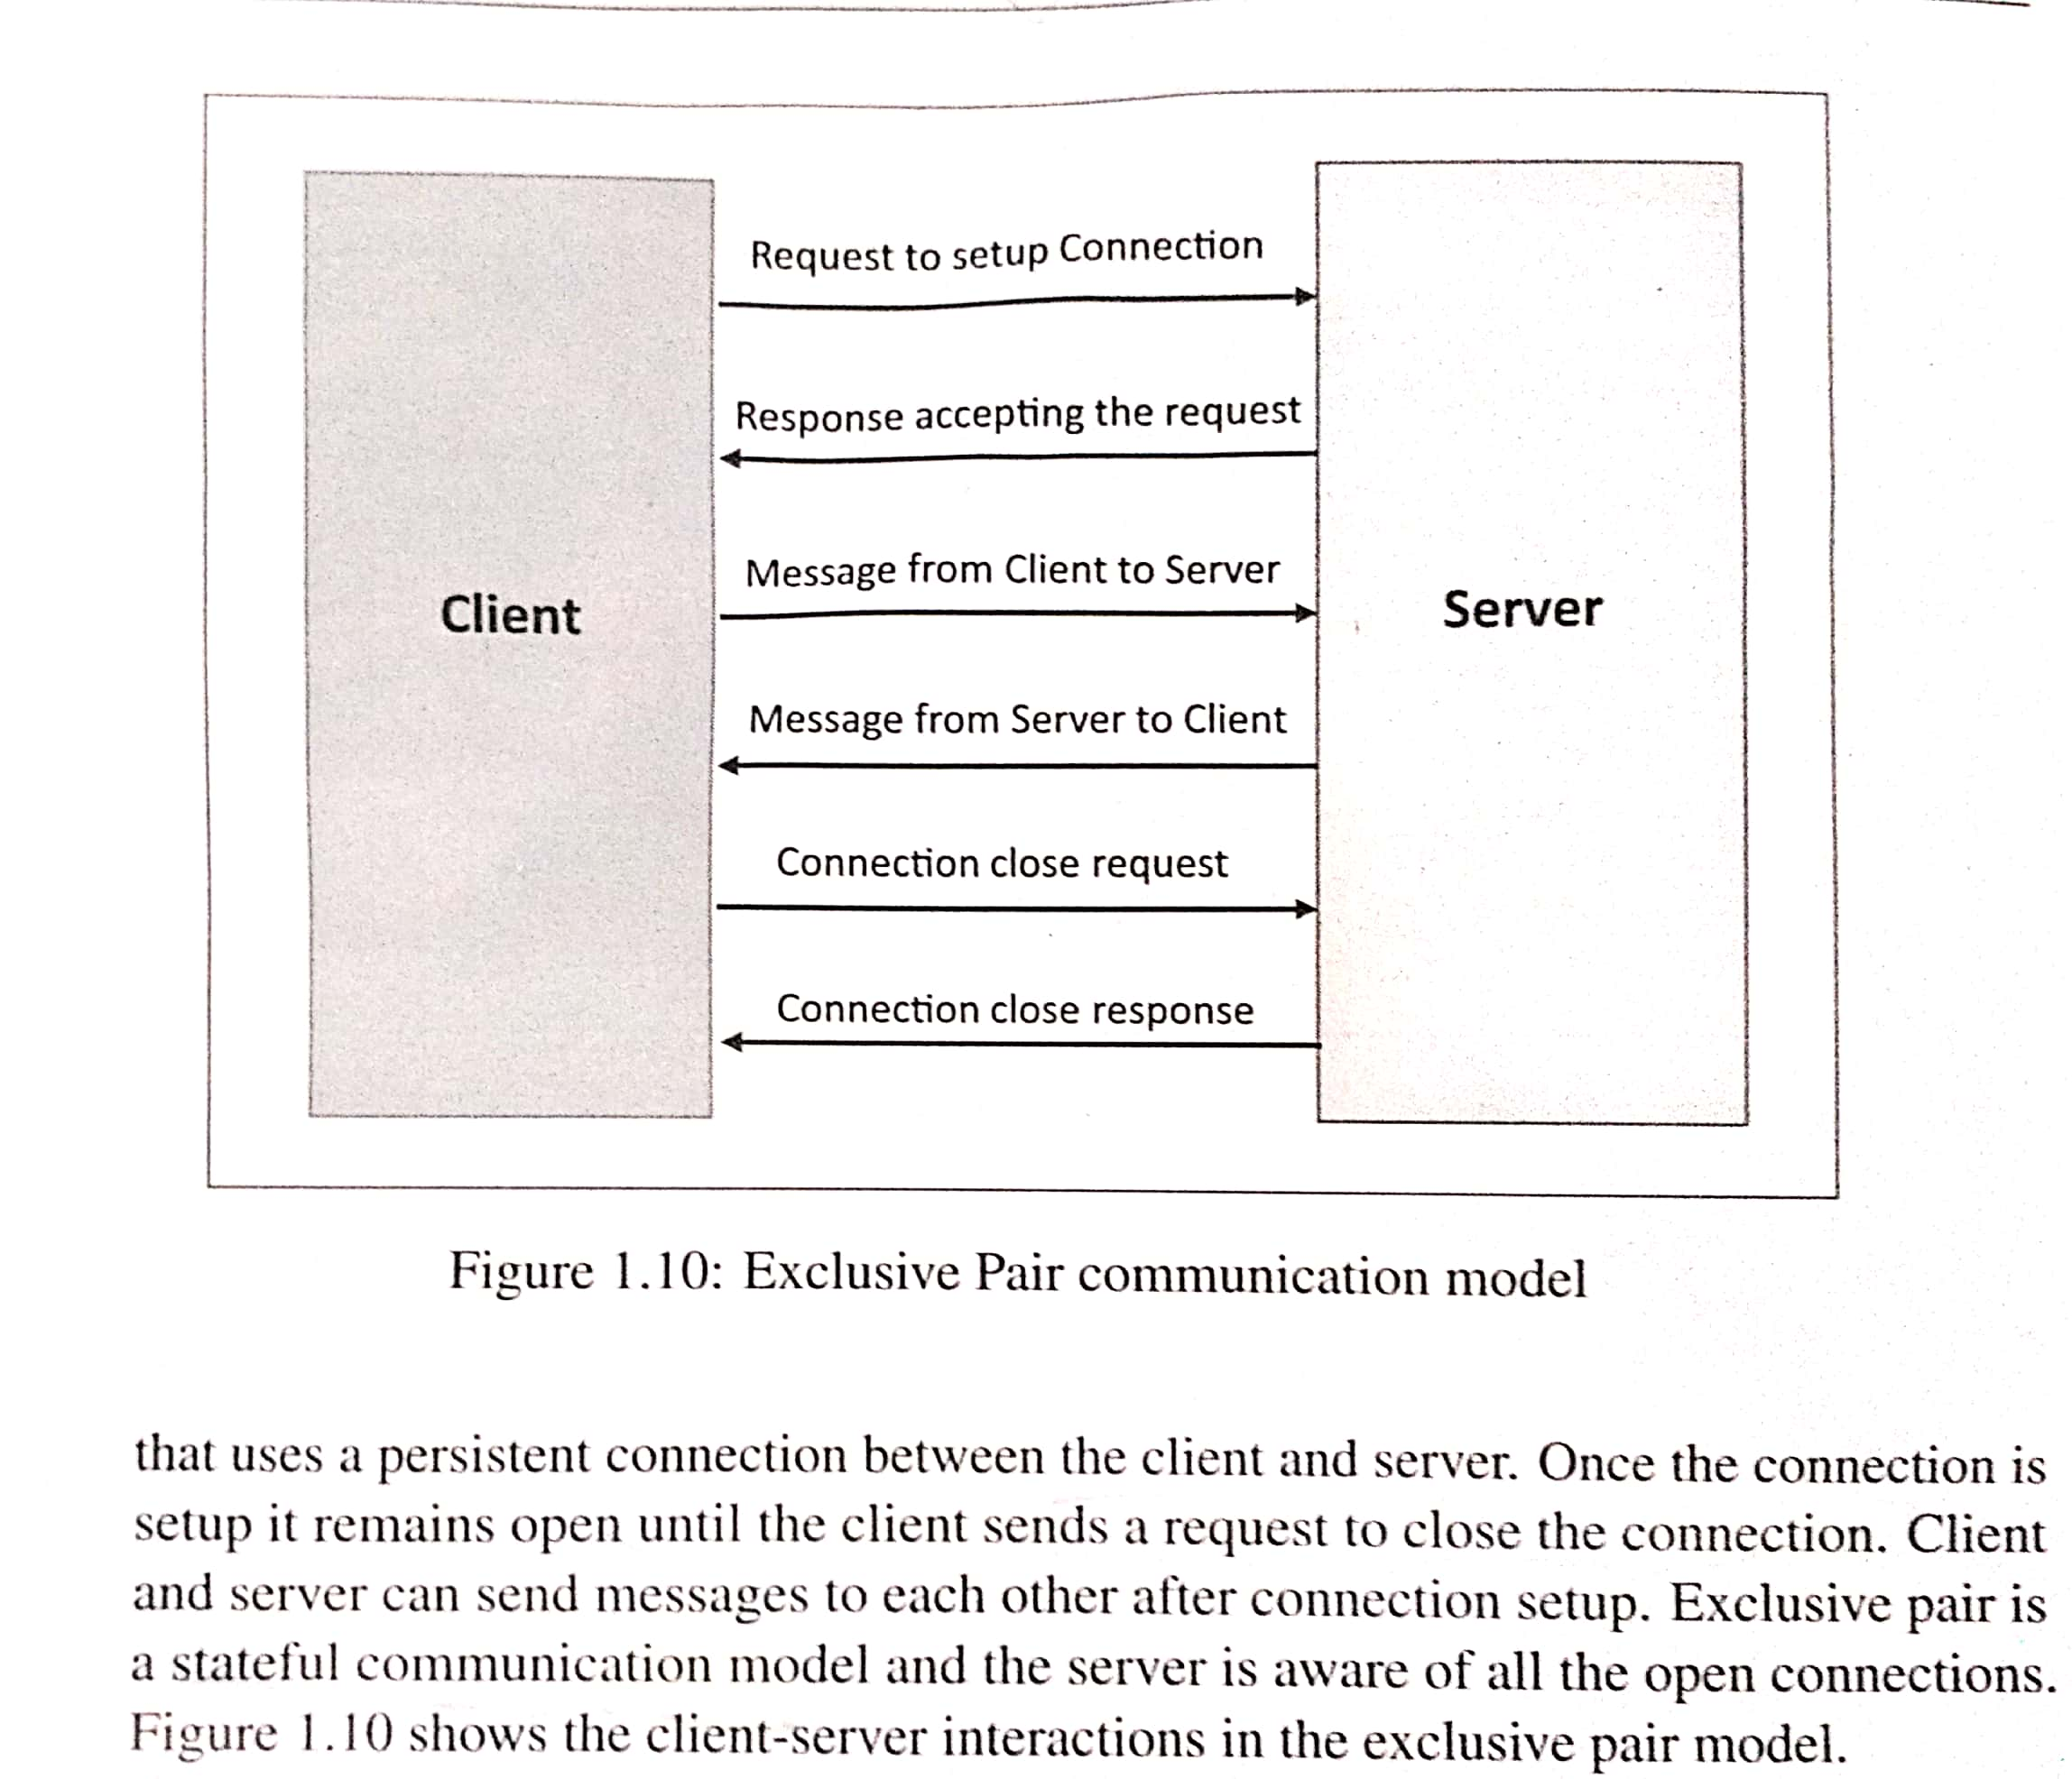
IoT Communication Models

